Slide 1
Storage Server For Apartment buildings
Team 37
Aryamman Jain
Pranav Mehndiratta
Vaibhav Vijay
Notes:
Introduce yourself and team

Slide 2

Overview
Data management at apartment buildings
Need efficient means of storage and methods for maintaining this data
Usage of hash tables and C string libraries to implement system
Performance of aforementioned approaches
Importance of organizing data
Notes:
We are here today to discuss and solve the problem faced by residential buildings due to the large amount of data generated. To demonstrate the usage of our application as a solution, a use case scenario of the application is discussed.
There were many design challenges of this system. The in depth discussion involves the usage of the hash table data structure and the methods of parsing the input data using C string libraries.
In the second half of our presentation, we will analyze the performance results of using the server with and without concurrency
We conclude by discussing the importance of organizing information to make it more valuable.

Slide 3


Residential Data Management
Client: management, superintendent, security
Problem
Current system is fully paper based and unorganized
Access is slow and inaccurate
Solution
Data to be stored in hash tables and centralized at one location
Chosen data structure is built for quick access and consistent performance
Notes:
Residential buildings generate vast amounts of data every day that needs to be tracked for security and managerial purposes
This data includes tenant details, rent status, agreements, maintenance requests.
This information is primarily used by the management staff, the superintendent and the security guards at the building.
The current system is slow and subject to human error as the the process is completely manual using paper as a storage medium.
We propose to use a storage server that will store all records in a hash table.
This server has a client-side user interface that allows for functionalities of accessing, inserting or modifying a record,.
Searching for multiple records based on given condition, named get, set and query can also be done.
We take in the data from the user and parse it into a format that the server understands using string manipulations with standard C functions.

Slide 4


What Data Structure are we Using?
Requirements:
Direct access of a tenant record
Capable of storing large amounts of data
Easy to maintain
Our pick: Hash Table
Why?
Possibility of collisions
Clustering of data
Known number of entries
Alternatives: array, linked list, binary search tree, hash table
Fast access
Consistent performance
Easy to perform operations
Notes:
A data structure must be used to organize the storage of this information
2 main qualities of data storage that concern our client are speed and ability to handle many records without losing accuracy.
The data structure chosen should allow for quick insertion/ deletion/ searching of records that ideally doesn’t decrease with an increasing data.
There are various data structures to use like arrays, linked lists, trees and hash tables.
For all data structures except hash tables, performance quickly deteriorates with increasing number of records as, accessing a random record involves traversal of the data structure.
Therefore we use a hash table.
This provides very fast random record access by not involving any record traversal, thus making it easy to perform operations such as insert/modify/delete.
Since it provides direct access to a record, the performance doesn’t decrease as more records are stored in the database.
A hash tables has a fixed capacity, its performance decreases if it starts to fill up to its limit. The drawbacks of collisions and clustering of data with hash tables can be overcome as we know the maximum number of entries.

Slide 5
The Implementation of Our Structure
Key: Apartment number
Hashing function: Function to convert keys to addressable indices in array
Index: Position of data in array
Entry: Data to be recorded
Index
Entry
00
Hashing Function
01
“name John, phone 4167839045”
Key
0504
02
“name Abdul, phone 6475893045”
0901
1506
997
“name Sophia, phone 4168745489”
2205
998
999
“name Suzan, phone 6478904382”
Notes:
Let me walk you through how the data is actually stored in our structure
We start with using apartment numbers as keys that are sent to the custom tailored hash function that creates addressable indices in an array.
We have made this function such that it is dependent on individual characters within the key, thus resulting in unique hashed indices. This means that there shall be minimal collisions, thus minimizing any decrease in performance due to the collision problem.
Finally, the record itself is stored at the “hashed index” in the array

Slide 6
How are We Reading Data?
Requirements:
Robustness
Handling different characters
Identifying errors
Our pick: String Manipulation
Why?
Types: User commands, storage data, configuration
Alternatives: string manipulation, Lex/Yacc (or similar tools)
Manually done
Not easily scalable
Simplicity
No learning curve
Close control of functionality
Notes:
Prior to storing the data, we must take it in raw form from the user.
There are certain requirements that our parsing method must meet
It needs to be robust; meaning it must be capable of handling different forms of input
It should be fully equipped to identify possible errors that could cause unpredictable behaviour
The three main sources that require parsing are commands coming from the user, our communication protocol (which is discussed later), and the configuration file
Despite having the opportunity to use an advanced parsing tool such as Lex/Yacc, we chose to use string manipulation to parse data because Lex/Yacc has a steeper learning curve than using built in functions, which are very straight forward to use and highly flexible.
Although using these functions requires manual definitions to recognize valid input, the versatility of using strtok() and sscanf() allows us to do this easily. It does not require any external knowledge outside that of C.

Slide 7
The implementation of Parsing
strtok() and sscanf() are C string library functions
Each string token is parsed using variations of sscanf()
Value to read from user
Run strtok() with ','
Individual strings obtained from running strtok()
Run a form of sscanf() to parse string token
name John Smith, phone 6472930375, vehicles 1
name John Smith| phone 6472930375| vehicles 1
name John Smith
phone 6472930375
vehicles 1
For the database: name = “John Smith”, phone = 6472930375, vehicles = 1
Notes:
There are other features that our storage server also employs to improve the usage of this application, however these are not as important and we shall only mention them briefly.
Our server can support multiple clients accessing the server simultaneously using threads. It also employs transactions and versioning of records to ensure there are no conflicts when multiple clients attempt to modify the same record.
By creating a log file based on thread ID and timestamp, we can maintain logging for each thread without any conflicts, therefore helping us to monitor the code flow closely and simplifying the debugging process.
The communication protocol between the client-server takes most of the time in the end-to-end delay, thus the amount of data to be sent across should be minimized. An example of the protocol for the GET command is shown, the other commands follow a similar approach.

Slide 8

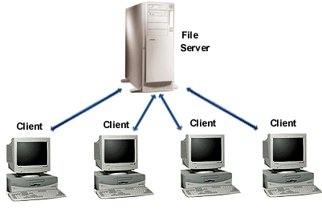
Additional Server Features
Request
GET #table #key
GET #table #key #value
Concurrency
Logging
Protocol
Response
Server capable of handling up to 10 clients simultaneously
Thread-safe log files created on user’s computer
Minimize data needed to be transmitted between client library and server
Notes:
Besides parsing our storage server also improves the usage of this application.
It can support multiple clients accessing the server simultaneously using threads.
It also employs transactions and versioning of records to ensure there are no conflicts when multiple clients attempt to modify the same record. This prevents “race conditions”.
By creating a log file based on thread ID and timestamp, we can maintain logging for each thread.
This helps us monitor the code flow closely and simplifies the debugging process.
The communication protocol between the client-server takes most of the time in the end-to-end delay, thus the amount of data to be sent across should be minimized. An example of the protocol for the GET command is shown, the other commands follow a similar approach.

Slide 9
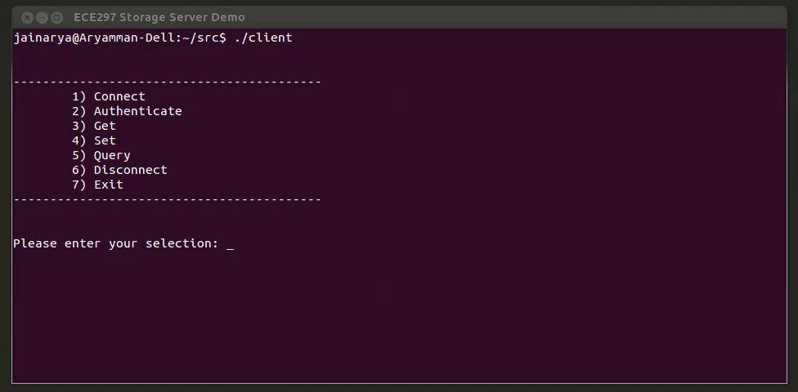
Use Case Scenario: Management Office updating a Tenant Record
Notes:
These commands are used to control this client application.
A particularly frequent one is updating stored contact information of tenants in the building.
We have prepared a short video demonstration of how the client can do this through the shell interface.
Video starts
The client starts by establishing a connection with the server using the provided interface.
They then input their credentials for the server to verify their identity as a certified user.
After successful authorization, they then look for the record they want to update, by using the Get command paired with the name of the table that contains the data to be updated and the key of the particular record.
The server responds with the value of the record if it exists.
Now, the client performs the update by using the Set command paired with the table name, key and a new value.
Following which, the server responds a success message if it was able to make the change in the database.

Slide 10
End-to-End Evaluation Results
Single Client
Multiple Clients
Notes:
Ensure real world load tests simulated clients
Trendline independent of requests O(1)
Slowest query transmit data protocol 118 unnoticeable
Decline in performance linear
Small number of end users regardless not noticeable after 10 clients

Slide 11

Chaos was the law of nature; Order was the dream of man
Henry Adams
Notes:
The purpose of the storage server is to provide a centralized database for storage of various data. A structured approach to handling massive data enables positive utilization of gathered information, hence increasing the productivity of any management entity. Through better management, we can achieve higher

Slide 12
Other performance Results
Transaction: A pair of Get and Set requests to update a record
Test Cases
Constructed using check framework
Tested Get, Set and Query individually
Notes:
To ensure accuracy of our design, we ran a suite of unit tests for each command (i.e. get, set and query) using the Check framework, allowing us to easily test and track corner cases that are code could be vulnerable against. The test suite helped us find many non-trivial bugs in our application, some of which led us to modify our core data structure.
The right graph shows the impact on rate of transaction aborts due to an increasing number of concurrent clients. Transaction aborts happen very quickly after around 5 clients at a rate of around 10 per 50 transactions, however we won’t have as many concurrent clients and so this is not an important issue for our client.

